Slide 1
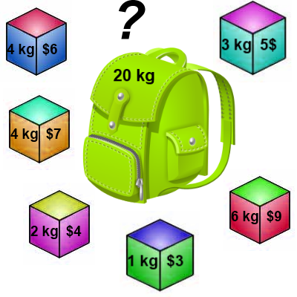
Knapsack 0-1 Problem
The goal is to maximize the value of a knapsack that can hold at most W units (i.e. lbs or kg) worth of goods from a list of items I₀, I₁, … I_{n-1}.
  Each item has 2 attributes:
    Value – let this be v_{i} for item I_{i}
    Weight – let this be w_{i} for item I_{i}

Slide 2
Knapsack 0-1 Problem
The difference between this problem and the fractional knapsack one is that you CANNOT take a fraction of an item.
  You can either take it or not.
  Hence the name Knapsack 0-1 problem.

Slide 3
Knapsack 0-1 Problem
Brute Force
  The naïve way to solve this problem is to cycle through all 2^{n} subsets of the n items and pick the subset with a legal weight that maximizes the value of the knapsack.
  We can come up with a dynamic programming algorithm that will USUALLY do better than this brute force technique.

Slide 4
Knapsack 0-1 Problem
As we did before we are going to solve the problem in terms of sub-problems.
  So let’s try to do that…
Our first attempt might be to characterize a sub-problem as follows:
  Let S_{k} be the optimal subset of elements from {I₀, I₁, …, I_{k}}.
    What we find is that the optimal subset from the elements {I₀, I₁, …, I_{k+1}} may not correspond to the optimal subset of elements from {I₀, I₁, …, I_{k}} in any regular pattern.
  Basically, the solution to the optimization problem for S_{k+1} might NOT contain the optimal solution from problem S_{k}.

Slide 5
Knapsack 0-1 Problem
Let’s illustrate that point with an example:
Item Weight Value
I₀ 3 10
I₁ 8 4
I₂ 9 9
I₃ 8 11
The maximum weight the knapsack can hold is 20.
The best set of items from {I₀, I₁, I₂} is {I₀, I₁, I₂}
BUT the best set of items from {I₀, I₁, I₂, I₃} is {I₀, I₂, I₃}.
  In this example, note that this optimal solution, {I₀, I₂, I₃}, does NOT build upon the previous optimal solution, {I₀, I₁, I₂}.
    (Instead it build's upon the solution, {I₀, I₂}, which is really the optimal subset of {I₀, I₁, I₂} with weight 12 or less.)

Slide 6
Knapsack 0-1 problem
So now we must re-work the way we build upon previous sub-problems…
  Let B[k, w] represent the maximum total value of a subset S_{k} with weight w.
  Our goal is to find B[n, W], where n is the total number of items and W is the maximal weight the knapsack can carry.
So our recursive formula for subproblems:
B[k, w] = B[k - 1,w], if w_{k} > w
= max { B[k - 1,w], B[k - 1,w - w_{k}] + v_{k}}, otherwise
In English, this means that the best subset of S_{k} that has total weight w is:
  The best subset of S_{k-1} that has total weight w, or
  The best subset of S_{k-1} that has total weight w-w_{k} plus the item k

Slide 7
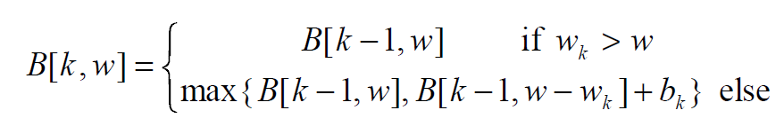
Knapsack 0-1 Problem –
Recursive Formula
The best subset of S_{k} that has the total weight w, either contains item k or not.
First case: w_{k} > w
  Item k can’t be part of the solution! If it was the total weight would be > w, which is unacceptable.
Second case: w_{k} ≤ w
  Then the item k can be in the solution, and we choose the case with greater value.

Slide 8
Knapsack 0-1 Algorithm
for w = 0 to W { // Initialize 1st row to 0’s
B[0,w] = 0
}
for i = 1 to n { // Initialize 1st column to 0’s
B[i,0] = 0
}
for i = 1 to n {
for w = 0 to W {
if w_{i} <= w { //item i can be in the solution
if v_{i} + B[i-1,w-w_{i}] > B[i-1,w]
B[i,w] = v_{i} + B[i-1,w- w_{i}]
else
B[i,w] = B[i-1,w]
}
else B[i,w] = B[i-1,w] // w_{i} > w
}
}

Slide 9
Knapsack 0-1 Problem
Let’s run our algorithm on the following data:
  n = 4 (# of elements)
  W = 5 (max weight)
  Elements (weight, value):
  (2,3), (3,4), (4,5), (5,6)

Slide 10
Knapsack 0-1 Example
i / w | 0 | 1 | 2 | 3 | 4 | 5
0 | 0 | 0 | 0 | 0 | 0 | 0
1 | 0
2 | 0
3 | 0
4 | 0
// Initialize the base cases
for w = 0 to W
B[0,w] = 0
for i = 1 to n
B[i,0] = 0

Slide 11
Knapsack 0-1 Example
Items:
1: (2,3)
2: (3,4)
3: (4,5)
4: (5,6)
i / w | 0 | 1 | 2 | 3 | 4 | 5
0 | 0 | 0 | 0 | 0 | 0 | 0
1 | 0
2 | 0
3 | 0
4 | 0
i / w | 0 | 1 | 2 | 3 | 4 | 5
0 | 0 | 0 | 0 | 0 | 0 | 0
1 | 0 | 0
2 | 0
3 | 0
4 | 0
i = 1
v_{i} = 3
w_{i} = 2
w = 1
w-w_{i} = -1
if w_{i} <= w //item i can be in the solution
if v_{i} + B[i-1,w-w_{i}] > B[i-1,w]
B[i,w] = v_{i} + B[i-1,w- w_{i}]
else
B[i,w] = B[i-1,w]
else B[i,w] = B[i-1,w] // w_{i} > w

Slide 12
Knapsack 0-1 Example
Items:
1: (2,3)
2: (3,4)
3: (4,5)
4: (5,6)
i / w | 0 | 1 | 2 | 3 | 4 | 5
0 | 0 | 0 | 0 | 0 | 0 | 0
1 | 0 | 0
2 | 0
3 | 0
4 | 0
i / w | 0 | 1 | 2 | 3 | 4 | 5
0 | 0 | 0 | 0 | 0 | 0 | 0
1 | 0 | 0 | 3
2 | 0
3 | 0
4 | 0
i = 1
v_{i} = 3
w_{i} = 2
w = 2
w-w_{i} = 0
if w_{i} <= w //item i can be in the solution
if v_{i} + B[i-1,w-w_{i}] > B[i-1,w]
B[i,w] = v_{i} + B[i-1,w- w_{i}]
else
B[i,w] = B[i-1,w]
else B[i,w] = B[i-1,w] // w_{i} > w
if w_{i} <= w //item i can be in the solution
if v_{i} + B[i-1,w-w_{i}] > B[i-1,w]
B[i,w] = v_{i} + B[i-1,w- w_{i}]
else
B[i,w] = B[i-1,w]
else B[i,w] = B[i-1,w] // w_{i} > w

Slide 13
Knapsack 0-1 Example
Items:
1: (2,3)
2: (3,4)
3: (4,5)
4: (5,6)
i / w | 0 | 1 | 2 | 3 | 4 | 5
0 | 0 | 0 | 0 | 0 | 0 | 0
1 | 0 | 0 | 3
2 | 0
3 | 0
4 | 0
i / w | 0 | 1 | 2 | 3 | 4 | 5
0 | 0 | 0 | 0 | 0 | 0 | 0
1 | 0 | 0 | 3 | 3
2 | 0
3 | 0
4 | 0
i = 1
v_{i} = 3
w_{i} = 2
w = 3
w-w_{i} = 1
if w_{i} <= w //item i can be in the solution
if v_{i} + B[i-1,w-w_{i}] > B[i-1,w]
B[i,w] = v_{i} + B[i-1,w- w_{i}]
else
B[i,w] = B[i-1,w]
else B[i,w] = B[i-1,w] // w_{i} > w

Slide 14
Knapsack 0-1 Example
Items:
1: (2,3)
2: (3,4)
3: (4,5)
4: (5,6)
i / w | 0 | 1 | 2 | 3 | 4 | 5
0 | 0 | 0 | 0 | 0 | 0 | 0
1 | 0 | 0 | 3 | 3
2 | 0
3 | 0
4 | 0
i / w | 0 | 1 | 2 | 3 | 4 | 5
0 | 0 | 0 | 0 | 0 | 0 | 0
1 | 0 | 0 | 3 | 3 | 3
2 | 0
3 | 0
4 | 0
i = 1
v_{i} = 3
w_{i} = 2
w = 4
w-w_{i} = 2
if w_{i} <= w //item i can be in the solution
if v_{i} + B[i-1,w-w_{i}] > B[i-1,w]
B[i,w] = v_{i} + B[i-1,w- w_{i}]
else
B[i,w] = B[i-1,w]
else B[i,w] = B[i-1,w] // w_{i} > w

Slide 15
Knapsack 0-1 Example
Items:
1: (2,3)
2: (3,4)
3: (4,5)
4: (5,6)
i / w | 0 | 1 | 2 | 3 | 4 | 5
0 | 0 | 0 | 0 | 0 | 0 | 0
1 | 0 | 0 | 3 | 3 | 3
2 | 0
3 | 0
4 | 0
i / w | 0 | 1 | 2 | 3 | 4 | 5
0 | 0 | 0 | 0 | 0 | 0 | 0
1 | 0 | 0 | 3 | 3 | 3 | 3
2 | 0
3 | 0
4 | 0
i = 1
v_{i} = 3
w_{i} = 2
w = 5
w-w_{i} = 3
if w_{i} <= w //item i can be in the solution
if v_{i} + B[i-1,w-w_{i}] > B[i-1,w]
B[i,w] = v_{i} + B[i-1,w- w_{i}]
else
B[i,w] = B[i-1,w]
else B[i,w] = B[i-1,w] // w_{i} > w

Slide 16
Knapsack 0-1 Example
Items:
1: (2,3)
2: (3,4)
3: (4,5)
4: (5,6)
i / w | 0 | 1 | 2 | 3 | 4 | 5
0 | 0 | 0 | 0 | 0 | 0 | 0
1 | 0 | 0 | 3 | 3 | 3 | 3
2 | 0
3 | 0
4 | 0
i / w | 0 | 1 | 2 | 3 | 4 | 5
0 | 0 | 0 | 0 | 0 | 0 | 0
1 | 0 | 0 | 3 | 3 | 3 | 3
2 | 0 | 0
3 | 0
4 | 0
i = 2
v_{i} = 4
w_{i} = 3
w = 1
w-w_{i} = -2
if w_{i} <= w //item i can be in the solution
if v_{i} + B[i-1,w-w_{i}] > B[i-1,w]
B[i,w] = v_{i} + B[i-1,w- w_{i}]
else
B[i,w] = B[i-1,w]
else B[i,w] = B[i-1,w] // w_{i} > w
if w_{i} <= w //item i can be in the solution
if v_{i} + B[i-1,w-w_{i}] > B[i-1,w]
B[i,w] = v_{i} + B[i-1,w- w_{i}]
else
B[i,w] = B[i-1,w]
else B[i,w] = B[i-1,w] // w_{i} > w

Slide 17
Knapsack 0-1 Example
Items:
1: (2,3)
2: (3,4)
3: (4,5)
4: (5,6)
i / w | 0 | 1 | 2 | 3 | 4 | 5
0 | 0 | 0 | 0 | 0 | 0 | 0
1 | 0 | 0 | 3 | 3 | 3 | 3
2 | 0 | 0
3 | 0
4 | 0
i / w | 0 | 1 | 2 | 3 | 4 | 5
0 | 0 | 0 | 0 | 0 | 0 | 0
1 | 0 | 0 | 3 | 3 | 3 | 3
2 | 0 | 0 | 3
3 | 0
4 | 0
i = 2
v_{i} = 4
w_{i} = 3
w = 2
w-w_{i} = -1
if w_{i} <= w //item i can be in the solution
if v_{i} + B[i-1,w-w_{i}] > B[i-1,w]
B[i,w] = v_{i} + B[i-1,w- w_{i}]
else
B[i,w] = B[i-1,w]
else B[i,w] = B[i-1,w] // w_{i} > w

Slide 18
Knapsack 0-1 Example
Items:
1: (2,3)
2: (3,4)
3: (4,5)
4: (5,6)
i / w | 0 | 1 | 2 | 3 | 4 | 5
0 | 0 | 0 | 0 | 0 | 0 | 0
1 | 0 | 0 | 3 | 3 | 3 | 3
2 | 0 | 0 | 3
3 | 0
4 | 0
i / w | 0 | 1 | 2 | 3 | 4 | 5
0 | 0 | 0 | 0 | 0 | 0 | 0
1 | 0 | 0 | 3 | 3 | 3 | 3
2 | 0 | 0 | 3 | 4
3 | 0
4 | 0
i = 2
v_{i} = 4
w_{i} = 3
w = 3
w-w_{i} = 0
if w_{i} <= w //item i can be in the solution
if v_{i} + B[i-1,w-w_{i}] > B[i-1,w]
B[i,w] = v_{i} + B[i-1,w- w_{i}]
else
B[i,w] = B[i-1,w]
else B[i,w] = B[i-1,w] // w_{i} > w
if w_{i} <= w //item i can be in the solution
if v_{i} + B[i-1,w-w_{i}] > B[i-1,w]
B[i,w] = v_{i} + B[i-1,w- w_{i}]
else
B[i,w] = B[i-1,w]
else B[i,w] = B[i-1,w] // w_{i} > w

Slide 19
Knapsack 0-1 Example
Items:
1: (2,3)
2: (3,4)
3: (4,5)
4: (5,6)
i / w | 0 | 1 | 2 | 3 | 4 | 5
0 | 0 | 0 | 0 | 0 | 0 | 0
1 | 0 | 0 | 3 | 3 | 3 | 3
2 | 0 | 0 | 3 | 4
3 | 0
4 | 0
i / w | 0 | 1 | 2 | 3 | 4 | 5
0 | 0 | 0 | 0 | 0 | 0 | 0
1 | 0 | 0 | 3 | 3 | 3 | 3
2 | 0 | 0 | 3 | 4 | 4
3 | 0
4 | 0
i = 2
v_{i} = 4
w_{i} = 3
w = 4
w-w_{i} = 1
if w_{i} <= w //item i can be in the solution
if v_{i} + B[i-1,w-w_{i}] > B[i-1,w]
B[i,w] = v_{i} + B[i-1,w- w_{i}]
else
B[i,w] = B[i-1,w]
else B[i,w] = B[i-1,w] // w_{i} > w

Slide 20
Knapsack 0-1 Example
Items:
1: (2,3)
2: (3,4)
3: (4,5)
4: (5,6)
i / w | 0 | 1 | 2 | 3 | 4 | 5
0 | 0 | 0 | 0 | 0 | 0 | 0
1 | 0 | 0 | 3 | 3 | 3 | 3
2 | 0 | 0 | 3 | 4 | 4
3 | 0
4 | 0
i / w | 0 | 1 | 2 | 3 | 4 | 5
0 | 0 | 0 | 0 | 0 | 0 | 0
1 | 0 | 0 | 3 | 3 | 3 | 3
2 | 0 | 0 | 3 | 4 | 4 | 7
3 | 0
4 | 0
i = 2
v_{i} = 4
w_{i} = 3
w = 5
w-w_{i} = 2
if w_{i} <= w //item i can be in the solution
if v_{i} + B[i-1,w-w_{i}] > B[i-1,w]
B[i,w] = v_{i} + B[i-1,w- w_{i}]
else
B[i,w] = B[i-1,w]
else B[i,w] = B[i-1,w] // w_{i} > w

Slide 21
Knapsack 0-1 Example
Items:
1: (2,3)
2: (3,4)
3: (4,5)
4: (5,6)
i / w | 0 | 1 | 2 | 3 | 4 | 5
0 | 0 | 0 | 0 | 0 | 0 | 0
1 | 0 | 0 | 3 | 3 | 3 | 3
2 | 0 | 0 | 3 | 4 | 4 | 7
3 | 0
4 | 0
i / w | 0 | 1 | 2 | 3 | 4 | 5
0 | 0 | 0 | 0 | 0 | 0 | 0
1 | 0 | 0 | 3 | 3 | 3 | 3
2 | 0 | 0 | 3 | 4 | 4 | 7
3 | 0 | 0 | 3 | 4
4 | 0
i = 3
v_{i} = 5
w_{i} = 4
w = 1..3
w-w_{i} = -3..-1
if w_{i} <= w //item i can be in the solution
if v_{i} + B[i-1,w-w_{i}] > B[i-1,w]
B[i,w] = v_{i} + B[i-1,w- w_{i}]
else
B[i,w] = B[i-1,w]
else B[i,w] = B[i-1,w] // w_{i} > w
if w_{i} <= w //item i can be in the solution
if v_{i} + B[i-1,w-w_{i}] > B[i-1,w]
B[i,w] = v_{i} + B[i-1,w- w_{i}]
else
B[i,w] = B[i-1,w]
else B[i,w] = B[i-1,w] // w_{i} > w

Slide 22
Knapsack 0-1 Example
Items:
1: (2,3)
2: (3,4)
3: (4,5)
4: (5,6)
i / w | 0 | 1 | 2 | 3 | 4 | 5
0 | 0 | 0 | 0 | 0 | 0 | 0
1 | 0 | 0 | 3 | 3 | 3 | 3
2 | 0 | 0 | 3 | 4 | 4 | 7
3 | 0 | 0 | 3 | 4
4 | 0
i / w | 0 | 1 | 2 | 3 | 4 | 5
0 | 0 | 0 | 0 | 0 | 0 | 0
1 | 0 | 0 | 3 | 3 | 3 | 3
2 | 0 | 0 | 3 | 4 | 4 | 7
3 | 0 | 0 | 3 | 4 | 5
4 | 0
i = 3
v_{i} = 5
w_{i} = 4
w = 4
w-w_{i} = 0
if w_{i} <= w //item i can be in the solution
if v_{i} + B[i-1,w-w_{i}] > B[i-1,w]
B[i,w] = v_{i} + B[i-1,w- w_{i}]
else
B[i,w] = B[i-1,w]
else B[i,w] = B[i-1,w] // w_{i} > w
if w_{i} <= w //item i can be in the solution
if v_{i} + B[i-1,w-w_{i}] > B[i-1,w]
B[i,w] = v_{i} + B[i-1,w- w_{i}]
else
B[i,w] = B[i-1,w]
else B[i,w] = B[i-1,w] // w_{i} > w

Slide 23
Knapsack 0-1 Example
Items:
1: (2,3)
2: (3,4)
3: (4,5)
4: (5,6)
i / w | 0 | 1 | 2 | 3 | 4 | 5
0 | 0 | 0 | 0 | 0 | 0 | 0
1 | 0 | 0 | 3 | 3 | 3 | 3
2 | 0 | 0 | 3 | 4 | 4 | 7
3 | 0 | 0 | 3 | 4 | 5
4 | 0
i / w | 0 | 1 | 2 | 3 | 4 | 5
0 | 0 | 0 | 0 | 0 | 0 | 0
1 | 0 | 0 | 3 | 3 | 3 | 3
2 | 0 | 0 | 3 | 4 | 4 | 7
3 | 0 | 0 | 3 | 4 | 5 | 7
4 | 0
i = 3
v_{i} = 5
w_{i} = 4
w = 5
w-w_{i} = 1
if w_{i} <= w //item i can be in the solution
if v_{i} + B[i-1,w-w_{i}] > B[i-1,w]
B[i,w] = v_{i} + B[i-1,w- w_{i}]
else
B[i,w] = B[i-1,w]
else B[i,w] = B[i-1,w] // w_{i} > w
if w_{i} <= w //item i can be in the solution
if v_{i} + B[i-1,w-w_{i}] > B[i-1,w]
B[i,w] = v_{i} + B[i-1,w- w_{i}]
else
B[i,w] = B[i-1,w]
else B[i,w] = B[i-1,w] // w_{i} > w

Slide 24
Knapsack 0-1 Example
Items:
1: (2,3)
2: (3,4)
3: (4,5)
4: (5,6)
i / w | 0 | 1 | 2 | 3 | 4 | 5
0 | 0 | 0 | 0 | 0 | 0 | 0
1 | 0 | 0 | 3 | 3 | 3 | 3
2 | 0 | 0 | 3 | 4 | 4 | 7
3 | 0 | 0 | 3 | 4 | 5 | 7
4 | 0
i / w | 0 | 1 | 2 | 3 | 4 | 5
0 | 0 | 0 | 0 | 0 | 0 | 0
1 | 0 | 0 | 3 | 3 | 3 | 3
2 | 0 | 0 | 3 | 4 | 4 | 7
3 | 0 | 0 | 3 | 4 | 5 | 7
4 | 0 | 0 | 3 | 4 | 5
i = 4
v_{i} = 6
w_{i} = 5
w = 1..4
w-w_{i} = -4..-1
if w_{i} <= w //item i can be in the solution
if v_{i} + B[i-1,w-w_{i}] > B[i-1,w]
B[i,w] = v_{i} + B[i-1,w- w_{i}]
else
B[i,w] = B[i-1,w]
else B[i,w] = B[i-1,w] // w_{i} > w
if w_{i} <= w //item i can be in the solution
if v_{i} + B[i-1,w-w_{i}] > B[i-1,w]
B[i,w] = v_{i} + B[i-1,w- w_{i}]
else
B[i,w] = B[i-1,w]
else B[i,w] = B[i-1,w] // w_{i} > w

Slide 25
Knapsack 0-1 Example
Items:
1: (2,3)
2: (3,4)
3: (4,5)
4: (5,6)
i / w | 0 | 1 | 2 | 3 | 4 | 5
0 | 0 | 0 | 0 | 0 | 0 | 0
1 | 0 | 0 | 3 | 3 | 3 | 3
2 | 0 | 0 | 3 | 4 | 4 | 7
3 | 0 | 0 | 3 | 4 | 5 | 7
4 | 0 | 0 | 3 | 4 | 5
i / w | 0 | 1 | 2 | 3 | 4 | 5
0 | 0 | 0 | 0 | 0 | 0 | 0
1 | 0 | 0 | 3 | 3 | 3 | 3
2 | 0 | 0 | 3 | 4 | 4 | 7
3 | 0 | 0 | 3 | 4 | 5 | 7
4 | 0 | 0 | 3 | 4 | 5 | 7
i = 4
v_{i} = 6
w_{i} = 5
w = 5
w-w_{i} = 0
if w_{i} <= w //item i can be in the solution
if v_{i} + B[i-1,w-w_{i}] > B[i-1,w]
B[i,w] = v_{i} + B[i-1,w- w_{i}]
else
B[i,w] = B[i-1,w]
else B[i,w] = B[i-1,w] // w_{i} > w
if w_{i} <= w //item i can be in the solution
if v_{i} + B[i-1,w-w_{i}] > B[i-1,w]
B[i,w] = v_{i} + B[i-1,w- w_{i}]
else
B[i,w] = B[i-1,w]
else B[i,w] = B[i-1,w] // w_{i} > w

Slide 26
Knapsack 0-1 Example
Items:
1: (2,3)
2: (3,4)
3: (4,5)
4: (5,6)
i / w | 0 | 1 | 2 | 3 | 4 | 5
0 | 0 | 0 | 0 | 0 | 0 | 0
1 | 0 | 0 | 3 | 3 | 3 | 3
2 | 0 | 0 | 3 | 4 | 4 | 7
3 | 0 | 0 | 3 | 4 | 5 | 7
4 | 0 | 0 | 3 | 4 | 5 | 7
We’re DONE!!
The max possible value that can be carried in this knapsack is $7

Slide 27
Knapsack 0-1 Algorithm
This algorithm only finds the max possible value that can be carried in the knapsack
  The value in B[n,W]
To know the items that make this maximum value, we need to trace back through the table.

Slide 28
Knapsack 0-1 Algorithm
Finding the Items
Let i = n and k = W
if B[i, k] ≠ B[i-1, k] then
mark the i^{th} item as in the knapsack
i = i-1, k = k-w_{i}
else
i = i-1 // Assume the i^{th} item is not in the knapsack
// Could it be in the optimally packed knapsack?

Slide 29
Knapsack 0-1 Algorithm
Finding the Items
Items:
1: (2,3)
2: (3,4)
3: (4,5)
4: (5,6)
Knapsack:
i / w | 0 | 1 | 2 | 3 | 4 | 5
0 | 0 | 0 | 0 | 0 | 0 | 0
1 | 0 | 0 | 3 | 3 | 3 | 3
2 | 0 | 0 | 3 | 4 | 4 | 7
3 | 0 | 0 | 3 | 4 | 5 | 7
4 | 0 | 0 | 3 | 4 | 5 | 7
i = 4
k = 5
v_{i} = 6
w_{i} = 5
B[i,k] = 7
B[i-1,k] = 7
i = n , k = W
while i, k > 0
if B[i, k] ≠ B[i-1, k] then
mark the i^{th} item as in the knapsack
i = i-1, k = k-w_{i}
else
i = i-1

Slide 30
Knapsack 0-1 Algorithm
Finding the Items
Items:
1: (2,3)
2: (3,4)
3: (4,5)
4: (5,6)
Knapsack:
i / w | 0 | 1 | 2 | 3 | 4 | 5
0 | 0 | 0 | 0 | 0 | 0 | 0
1 | 0 | 0 | 3 | 3 | 3 | 3
2 | 0 | 0 | 3 | 4 | 4 | 7
3 | 0 | 0 | 3 | 4 | 5 | 7
4 | 0 | 0 | 3 | 4 | 5 | 7
i = 3
k = 5
v_{i} = 5
w_{i} = 4
B[i,k] = 7
B[i-1,k] = 7
i = n , k = W
while i, k > 0
if B[i, k] ≠ B[i-1, k] then
mark the i^{th} item as in the knapsack
i = i-1, k = k-w_{i}
else
i = i-1

Slide 31
Knapsack 0-1 Algorithm
Finding the Items
Items:
1: (2,3)
2: (3,4)
3: (4,5)
4: (5,6)
Knapsack:
Item 2
i / w | 0 | 1 | 2 | 3 | 4 | 5
0 | 0 | 0 | 0 | 0 | 0 | 0
1 | 0 | 0 | 3 | 3 | 3 | 3
2 | 0 | 0 | 3 | 4 | 4 | 7
3 | 0 | 0 | 3 | 4 | 5 | 7
4 | 0 | 0 | 3 | 4 | 5 | 7
i = 2
k = 5
v_{i} = 4
w_{i} = 3
B[i,k] = 7
B[i-1,k] = 3
k – w_{i} = 2
i = n , k = W
while i, k > 0
if B[i, k] ≠ B[i-1, k] then
mark the i^{th} item as in the knapsack
i = i-1, k = k-w_{i}
else
i = i-1

Slide 32
Knapsack 0-1 Algorithm
Finding the Items
Items:
1: (2,3)
2: (3,4)
3: (4,5)
4: (5,6)
Knapsack:
Item 2
Item 1
i / w | 0 | 1 | 2 | 3 | 4 | 5
0 | 0 | 0 | 0 | 0 | 0 | 0
1 | 0 | 0 | 3 | 3 | 3 | 3
2 | 0 | 0 | 3 | 4 | 4 | 7
3 | 0 | 0 | 3 | 4 | 5 | 7
4 | 0 | 0 | 3 | 4 | 5 | 7
i = 1
k = 2
v_{i} = 3
w_{i} = 2
B[i,k] = 3
B[i-1,k] = 0
k – w_{i} = 0
i = n , k = W
while i, k > 0
if B[i, k] ≠ B[i-1, k] then
mark the i^{th} item as in the knapsack
i = i-1, k = k-w_{i}
else
i = i-1

Slide 33
Knapsack 0-1 Algorithm
Finding the Items
Items:
1: (2,3)
2: (3,4)
3: (4,5)
4: (5,6)
Knapsack:
Item 2
Item 1
i / w | 0 | 1 | 2 | 3 | 4 | 5
0 | 0 | 0 | 0 | 0 | 0 | 0
1 | 0 | 0 | 3 | 3 | 3 | 3
2 | 0 | 0 | 3 | 4 | 4 | 7
3 | 0 | 0 | 3 | 4 | 5 | 7
4 | 0 | 0 | 3 | 4 | 5 | 7
i = 1
k = 2
v_{i} = 3
w_{i} = 2
B[i,k] = 3
B[i-1,k] = 0
k – w_{i} = 0
k = 0, so we’re DONE!
The optimal knapsack should contain:
Item 1 and Item 2

Slide 34
Knapsack 0-1 Problem – Run Time
for w = 0 to W
B[0,w] = 0
for i = 1 to n
B[i,0] = 0
for i = 1 to n
for w = 0 to W
< the rest of the code >
What is the running time of this algorithm?
O(n*W)
Remember that the brute-force algorithm takes: O(2^{n})
O(W)
O(n)
Repeat n times
O(W)

Slide 35
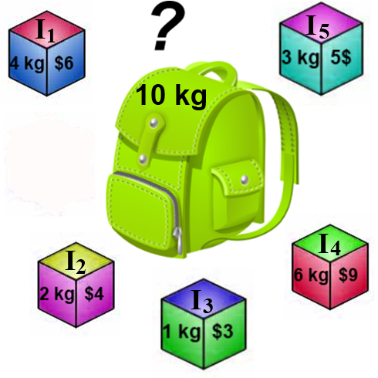
Knapsack Problem
Fill out the dynamic programming table for the knapsack problem to the right.
Trace back through the table to find the items in the knapsack.

Slide 36
Thank You

Slide 37
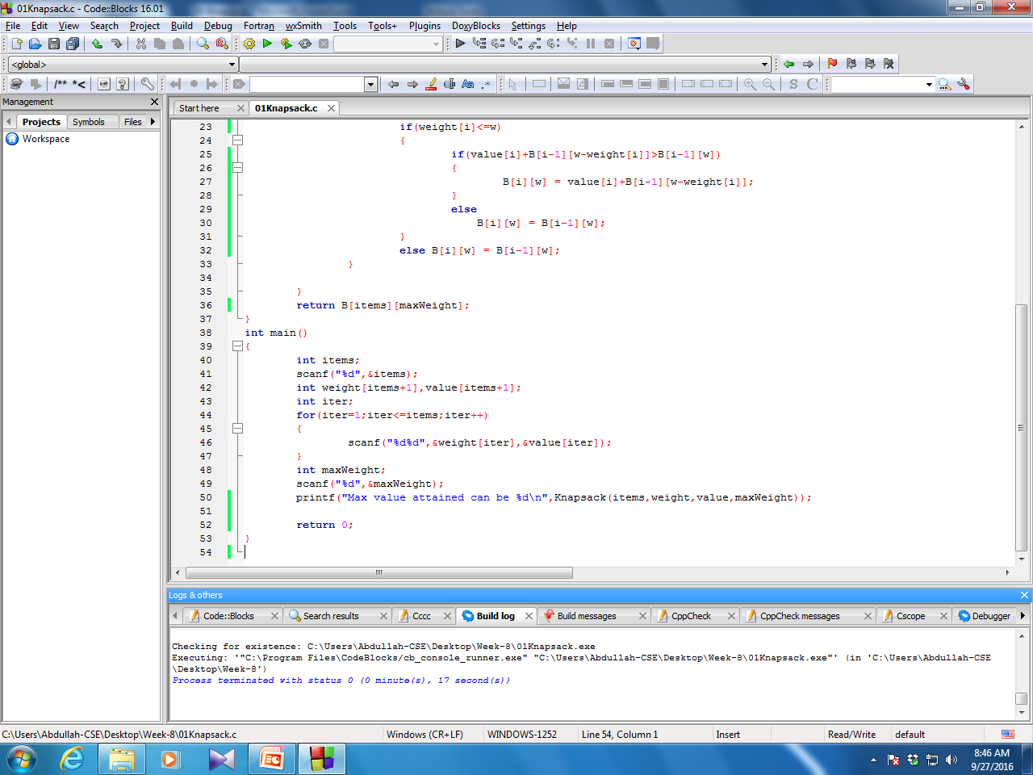
Coding

Slide 38
